Slide 1

Twitter
We need your help!
Tweet!
Learning Sentiment Analysis now #BDUmeetup @BigDataU
Notes:
Because we have the name change and we’re trying our best to educate as many people as possible, we need your help in getting the message out to everyone! Please take the opportunity now to help us by tweeting something about tonight’s meetup.

Slide 2

Launch of data science workshop series
Tuesdays 6pm - 8:30pm: DS for Beginners
Thursdays 6pm - 8:30pm: DS for Intermediate/Advanced
Meetups will be live streamed and recorded

Slide 3

www.datascientistworkbench.com

Slide 4
Sentiment Analysis
Using Twitter to model public opinion on the Canadian election

Slide 5
Example case study
Election years are one of the most polarizing times in any democratic society
Citizens: have incredibly strong opinions about candidates and collectively decide the outcome
Candidates: must be constantly informed about these opinions, who they are coming from and what specifically they are about
Companies: especially those that trade on capital markets often find themselves at a stalemate at times very close to an election as the results may drastically alter the performance of their portfolios
Notes:
I would personally keep them separated, and mention something like even developers at IBM

Slide 6
Question: Can we use sentiment analysis on Twitter data to get insight into this tumultuous and important political landscape?

Slide 7
Setting the Stage
In the last two decades the world has seen an incredible shift in text media from print-based to web-based
Literature has been made increasingly available online through resources like Google Books, Project Gutenberg, etc.
News organizations have responded by providing online resources with real-time newsfeeds
Social Media has become ubiquitous and enables an unprecedented access to the thoughts and opinions of ordinary people
Notes:
I would personally keep them separated, and mention something like even developers at IBM

Slide 8
Setting the Stage
What does this mean for us as data scientists?
More data!
More easily accessible data!
More opportunities for valuable analysis
Notes:
I would personally keep them separated, and mention something like even developers at IBM

Slide 9

Setting the stage
Dealing with this wealth of data may seem overwhelming, taking advantage of it – even more so

Slide 10
In this presentation
What this presentation will teach you:
How to apply Big Data and Machine Learning techniques to text data
How to use IBM’s Data Science Workbench to solve real problems with text data
How to perform one of the most in-demand applications of machine learning today: Sentiment Analysis

Slide 11
Sentiment analysis
Sentiment analysis is a field of natural language processing (NLP) in which we algorithmically determine whether a statement or document is “positive” or “negative”

Slide 12
Sentiment analysis
A number of things are pre-requisite to an effective sentiment analysis algorithm
Text mining for relevant data
Processing the data (POS Tagging, spell correcting, subject determination)
Then there are two main approaches we can take
1) Treat it as a classification problem
2) Use an online resource to rank word sentiment scores and aggregate them

Slide 13
Sentiment analysis
1) In terms of classifying sentiment we need to:
Find sentiment tagged twitter data
Pre-process it using NLP
Train a classifier on the pre-processed data
Determine election relevant tweets and classify their sentiment as “positive” or “negative”

Slide 14
Why is (sa) a marketable skill
Imagine you are the chairman of a company
If you’ve just released a new product: you want to have the immediate feedback of your customers
If you offer a service: you want to know right away if a customer is dissatisfied, you want to know if there are patterns in the times of dissatisfaction that can be addressed (e.g. wait times may be longer during certain times so you can make sure more staff is available during those times)

Slide 15
Why is (sa) a marketable skill
Imagine you are the chairman of a company
If you trade on capital markets: you will want to know if financial news outlets, popular finance blogs, or influential people have mentioned your company and if it was positive or negative

Slide 16
Setting up the project
In this project we will be using a variety of python packages and modules:
nltk: Natural Language Toolkit
re: python’s regular expression package
string: python’s string class
csv: python’s module for dealing with .csv files
Counter: python’s counting function

Slide 17
Setting up the project: Importing Modules
Throughout this project I will be importing packages and modules as needed so that their direct application is clear
If you’d like to import all of the modules at the start though you may use the following:

Slide 18
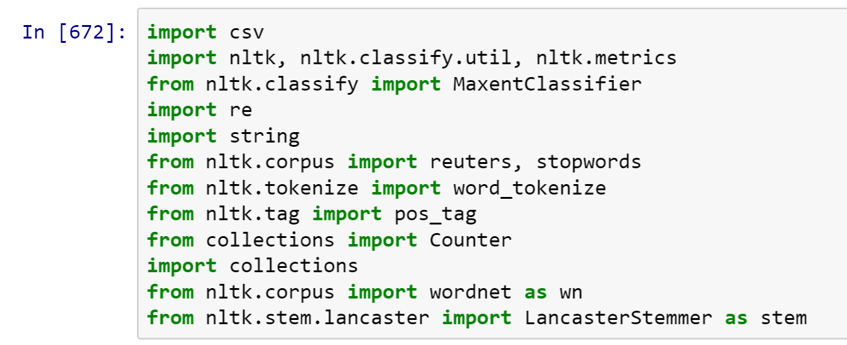
Setting up the project: Importing Modules

Slide 19
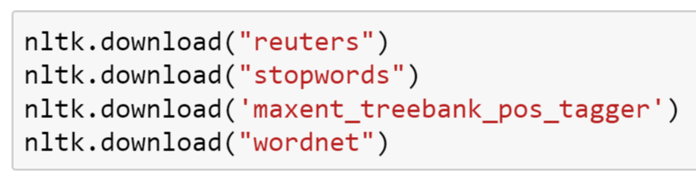
Downloading the data
In order to save space python’s Natural Language Toolkit requires you to download large texts using a the nltk downloader

Slide 20
Setting up the project: Loading the Data
To load the data into the Data Science Workbench we use
the !wget command

Slide 21
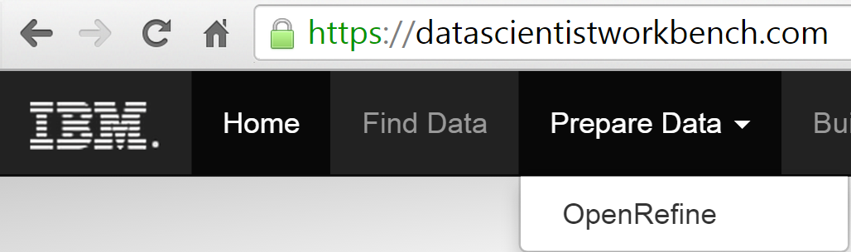
DSWB: Using Open refine to process the tweet corpus
You will need to:
Open the DataScience Workbench
Download the training.160000.csv file
Click on “Prepare Data”
Choose Open Refine
Choose “Sentiment140.200000”

Slide 22
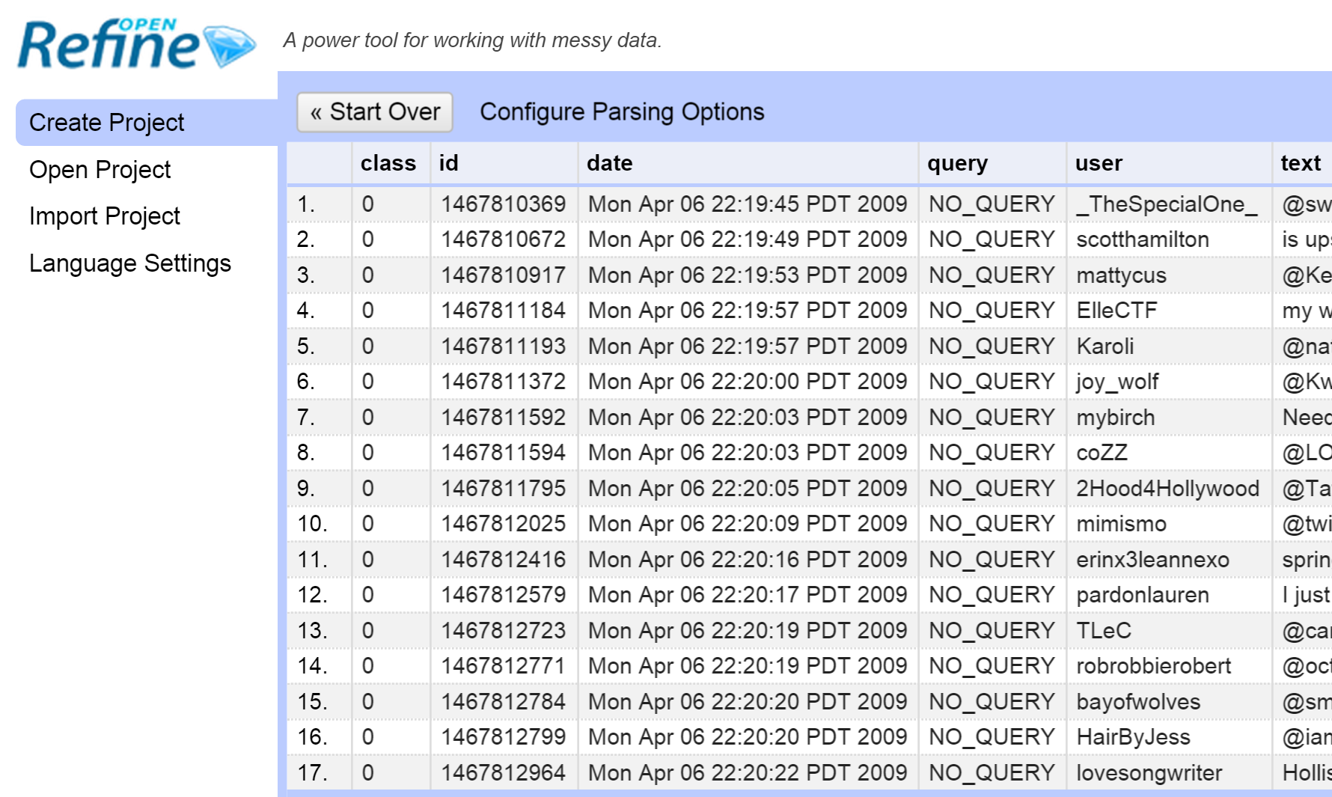
This!

Slide 23
What is a Corpus?
In text mining, a corpus is a large collection of text data
E.g. A collection of books, a collection of Wikipedia articles
In our case, we will use the Reuters dataset in the python nltk package
Otherwise available here: http://www.daviddlewis.com/resources/testcollections/reuters21578/

Slide 24
What is a Corpus?
For our Twitter data corpus we will use the Sentiment140 data from Stanford University available here:
http://cs.stanford.edu/people/alecmgo/trainingandtestdata.zip

Slide 25
What is a term Document Matrix?
A term-document matrix (TDM) is a common aspect of many different text mining processes, it is a useful representation of the corpus
A TDM is a matrix where each row is a word that appears in the corpus and each column is a different document in the corpus

Slide 26
What is a term Document Matrix?
The (i,j)th entry of the TDM is then the word-count of the ith word in the jth document
We will consider each Tweet its own document (in this context, the word document simply describes an individual element of the corpus

Slide 27
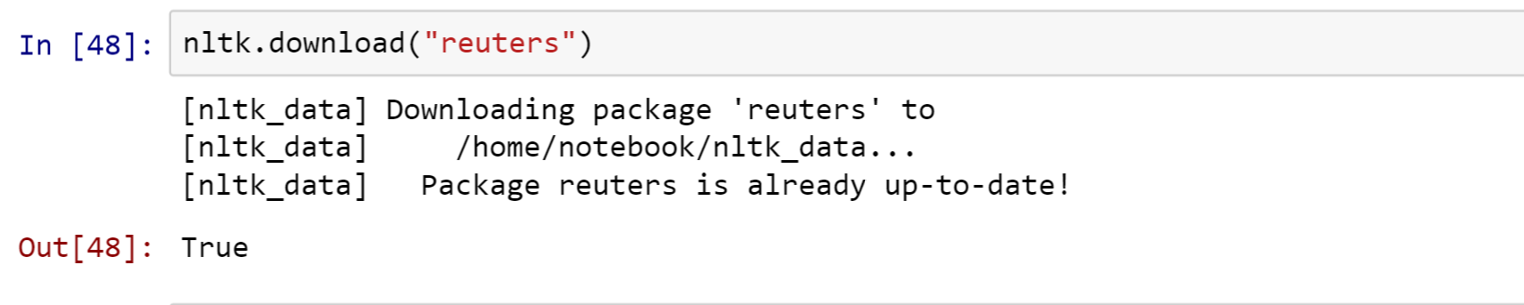
LOADING THE CORPUS INTO THE DATA SCIENCE WORKBENCH
The first thing we need to do is load the Reuters Corpus into the workbench
For this we need to use the nltk package
In order to save space python uses a “LazyCorpus” class if you try to import it right from nltk.corpus.reuters
We need to use the nltk downloader to get the corpus into the workbench like so:

Slide 28
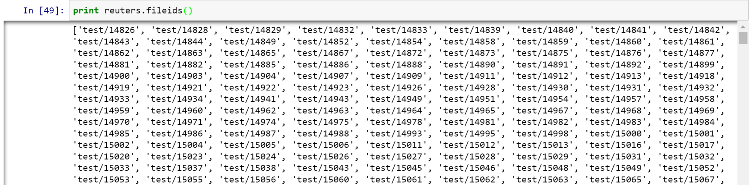
LOADING THE CORPUS INTO THE DATA SCIENCE WORKBENCH
We still have a bit of background to cover before we form the TDM but we can look through the Reuters file ids to see the different documents which will constitute it

Slide 29
Tokenization – NLp theory
We first must segment the data into words and sentences, this is called tokenization
We usually ignore words called stop words which typically have little or no consequence on semantic meaning

Slide 30
Tokenization – NLp theory
We may also choose to normalize the data so that we only represent base words (e.g. dogs, dogs’, dog’s -> dog)
Create a term-document matrix (TDM) with these normalized word-counts

Slide 31
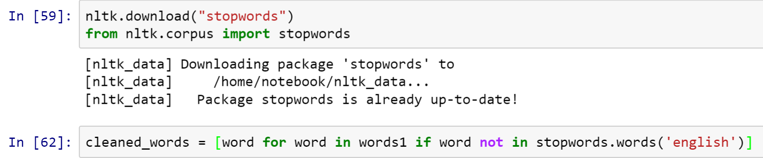
DSWB: Cleaning up the data
Dealing with stop words:
Again, python conveniently has a corpus of stop words
We need to import it and download it as with the Reuters corpus
Then we can simply loop through the words in our Reuters file and keep the ones that aren’t in the stop words corpus

Slide 32
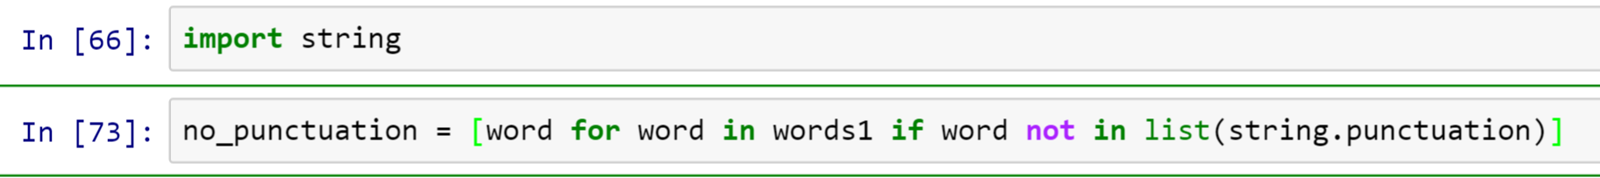
DSWB: Cleaning up the data
For punctuation removal we do something very similar except this time we use the “string” module

Slide 33
DSWB: Cleaning up the data
Of course we will need to be calling both of these on however many documents in the Reuters corpus as we want and given their similarity, it makes sense to put them into a function like so:

Slide 34
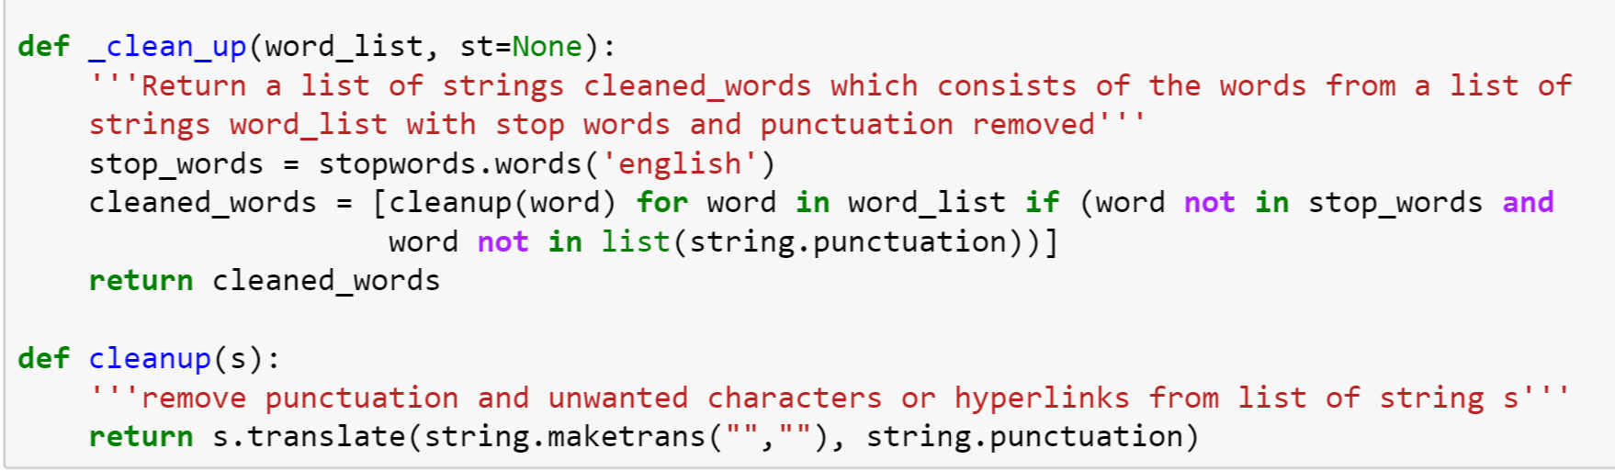
DSWB: Cleaning up the data

Slide 35
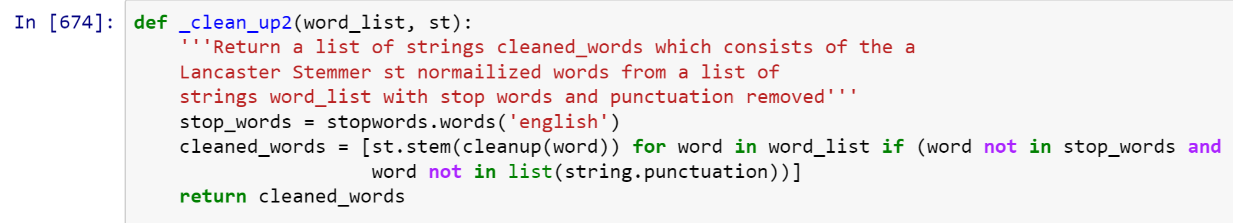
DSWB: Cleaning up the data
Later on in the project we will need to also normalize the twitter training data using a Lancaster Stemmer tool, here is that alternate cleanup function

Slide 36
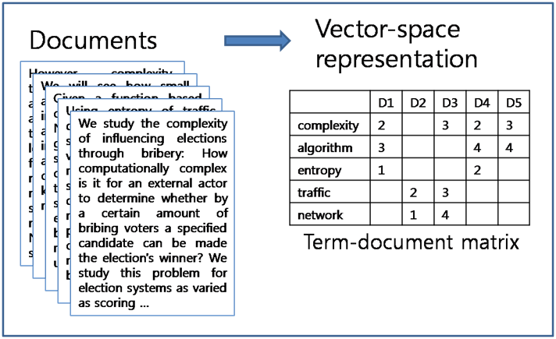
The Term Document Matrix (TDM)

Slide 37
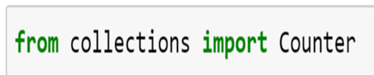
DSWB: Making the Reuters tdm
We need to go through each document in the Reuters corpus, clean the data, get the word-counts and add them to an array
In typical TDMs the data is represented as a matrix but in Python, dictionaries (hash tables in other languages) are much more efficient so we will use them first we need the Counter function

Slide 38
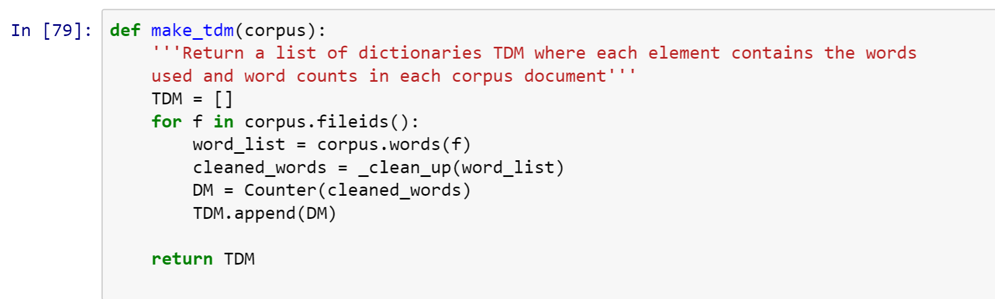
DSWB: Making the Reuters tdm
Putting it all together we can write the following function with everything we’ve developed so far

Slide 39
DSWB: Making the Reuters tdm
And then run

Slide 40
Spelling Errors
In all but the most refined sources of text data there will be spelling errors
Why is this a problem?
We can miss valuable information
We can’t POS tag a non-existent word

Slide 41
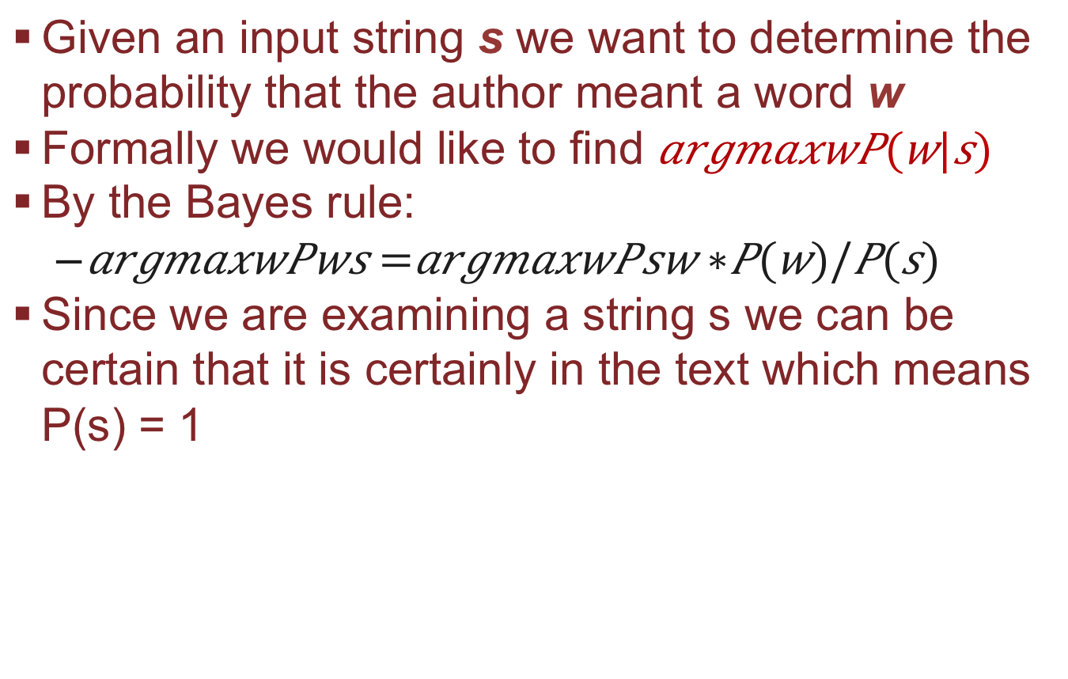
Formalization I
Given an input string s we want to determine the probability that the author meant a word w
Formally we would like to find
By the Bayes rule:
Since we are examining a string s we can be certain that it is certainly in the text which means P(s) = 1

Slide 42
Formalization II
Here P(w) is the probability of a word w occurring by itself in the text which we derive from the language model
For example P(“like”) is going to be relatively high while P(“pterodactyl”) will be relatively low

Slide 43
Formalization III
P(s|w) is the probability of a user mistakenly writing a string s when the word w was intended. We derive this from the error model
For example P(“likee” | “like”) will be relatively high while P(“pterodactly” | “like”) will be relatively low

Slide 44
Minimum Edit Distance
Developed by Wagner and Fischer in 1974
The minimum number of edit operations required to get to a desired word
Edit distance of 1 can be any one of 3 operations
3 Operations:
Insertion (i) (e.g. “like” -> “lijke”)
Deletion (d) (e.g. “like” -> “lik”)
Substitution (s) (e.g. “like” -> “liye”)

Slide 45
Minimum Edit Distance
Edit distance of 2 is any one of the operations applied (in such a way that the desired word is not achieved) on something that is an edit distance of 1 away (e.g. “lijje” -> “lije” -> “like”) [deletion + substitution]
We can use this as the basis for our error model

Slide 46
Special Thanks to Peter Norvig
In NLP Peter Norvig’s 21 line spell checker is (though not the most efficient) one of the most widely known examples for people trying to learn more about the subject
I have adapted his code to work for our Reuters TDM but you can view the original code and his explanations here: http://norvig.com/spell-correct.html

Slide 47
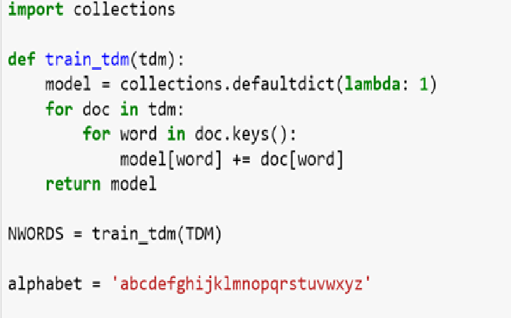
The spell Checker
First the part of the code adapted specifically for our TDM

Slide 48
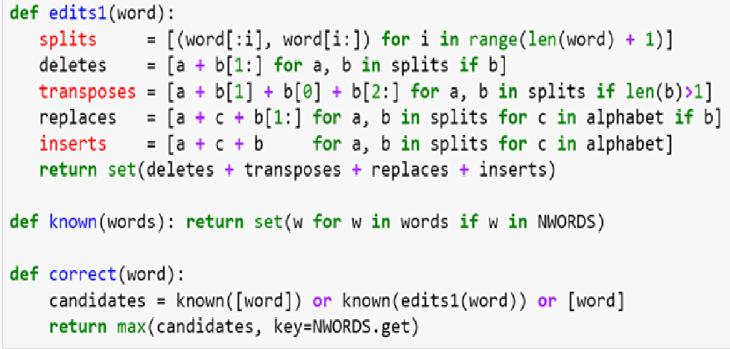
The spell Checker
Notice the line in which we get the max of all the candidates is just getting the word with the highest P(w) MLE estimate

Slide 49
POS tagging
Consider two sentences
“The Professor asked us to find the mean of the dataset”
“The Professor is mean”
Question: How do we differentiate between the two different uses of the same word?
Answer: Part of Speech Tagging (POST)

Slide 50
Part of speech tagging
POST is the practice of identifying the grammatical classes of words in a corpus based on their context and definition.
Most commonly used tagset is the Penn Treebank set and contains tags like:
NNP – Proper noun (e.g. John, Steven Harper)
PRP – Personal pronoun (e.g. me)
NN – Noun
NNS – Plural Noun

Slide 51
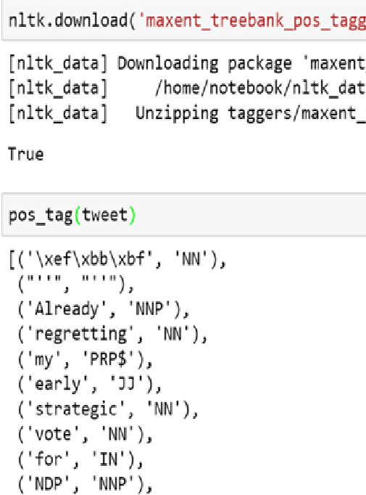
POS tagging using nltk
Then to get the POS tags of one of our tweets we need to download the treebank POS tagger
Then we simply use the pos_tag function we imported earlier

Slide 52
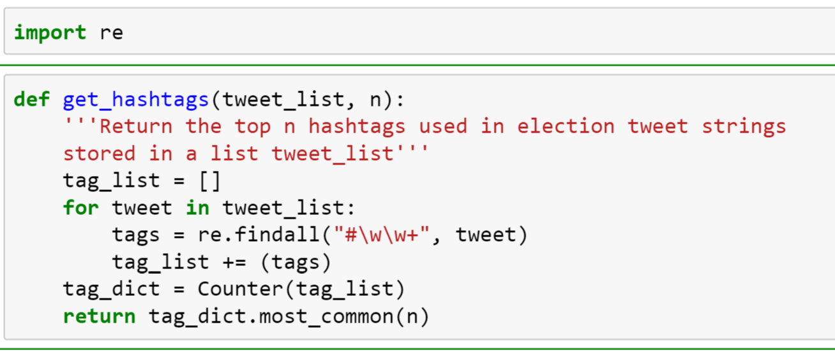
Finding Top Hashtags
For the first step we will use python’s regular expression module “re”
For the second we again use a Counter
The third we will implement in the next video

Slide 53
Filtering tags by party
First we expand and filter our hashtags by party
One key trick, many related hashtags are variants of a few original ones (e.g. “#istandwithharper” is a variant of “#harper”)

Slide 54
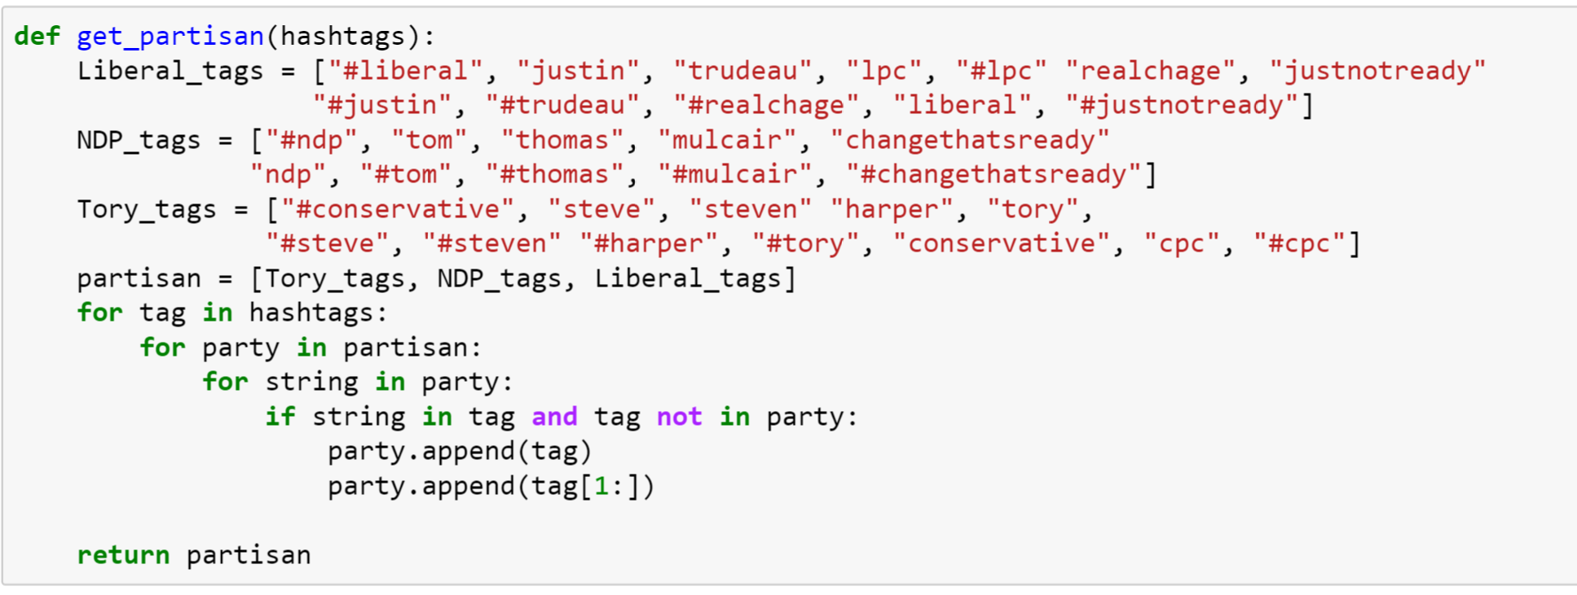
Filtering tags by party
Writing the function

Slide 55
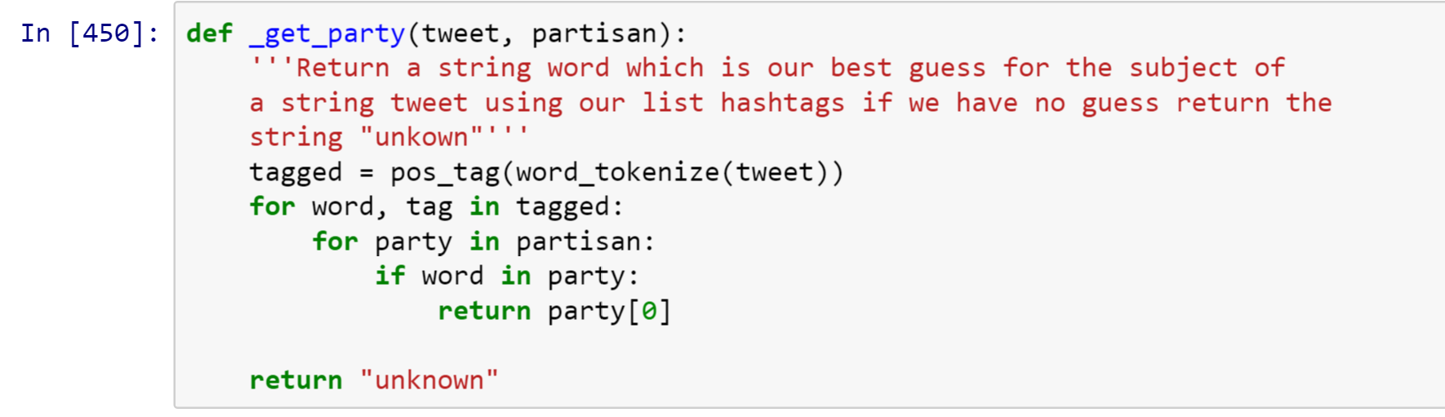
Writing the helper function
Putting all of that together we can process a given tweet as such

Slide 56
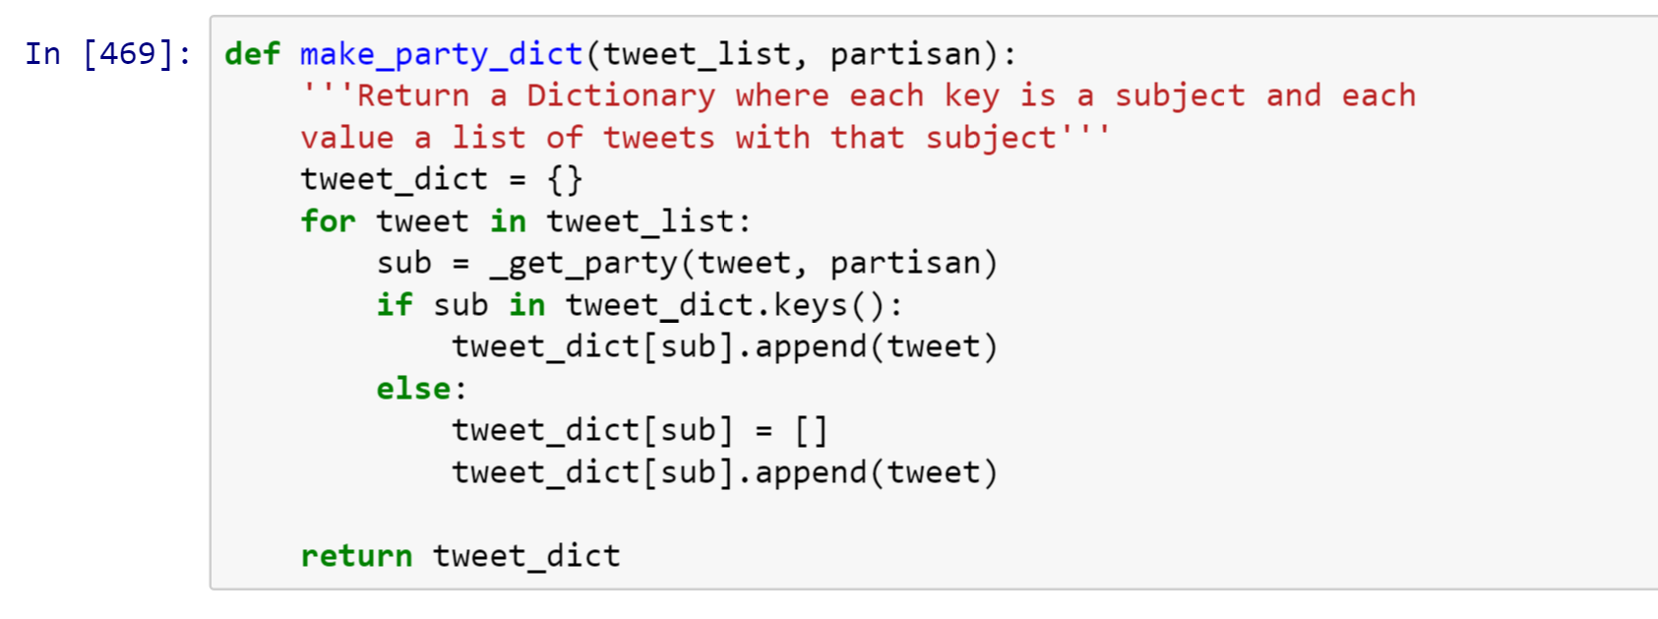
Writing the Main function
Now we simply need to write a function which finds each subject and sorts them by subject

Slide 57
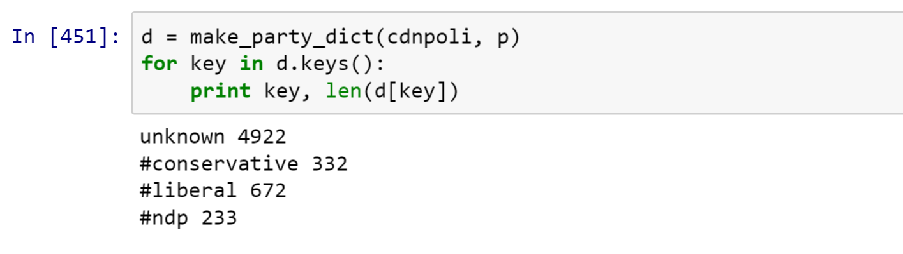
Our Test Data
And now we can save our test data in a dictionary
Now we just need to classify these results!

Slide 58
Text Classification
Classification is a very well known, well studied aspect of supervised machine learning (if it is unsupervised it is called clustering)

Slide 59
Text classification
In classification problems we have the luxury of having
Category names
Previously assigned members of each category (training data)

Slide 60
Text classification
Because of this we can conceptually outline the basic procedure as follows:
1) Train weights of a classifier by minimizing some error measure on the training data
2) Project training data into a vector space and remember their class labels
3) Project a test case into the same vector space and assign it the class label of whichever cluster it is closest to

Slide 61
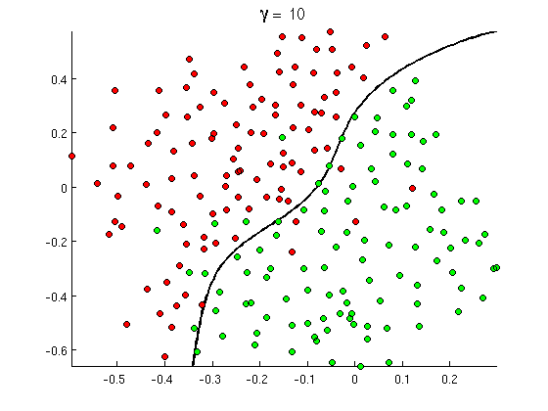
Text Classification 2-d Example
The Green Points are assigned the class label “Positive”, the red assigned “Negative”

Slide 62
Text Classification 2-d Example
The points on the wrong side of the boundary are ‘misclassified’ and contribute to our classification error, the boundary is fitted in such a way to minimize this

Slide 63
Naïve Bayes Classifier
Consider an input vector x consisting of k words (t₁, t₂,…, t_{k})
Our goal is to assign x to a class c based on the number of times each of these k words appear – in this case they are our features

Slide 64
Naïve Bayes Classifier
The idea in Naïve Bayes classification is to maximize the posterior probability that a vector x belongs to a class c (i.e. P(c|x))
Of course if we could explicitly calculate this then our job would be much easier
This leads to the primary insight in Naïve Bayes Classification, use the Bayes rule to get a tangible estimate of P(c|x)

Slide 65
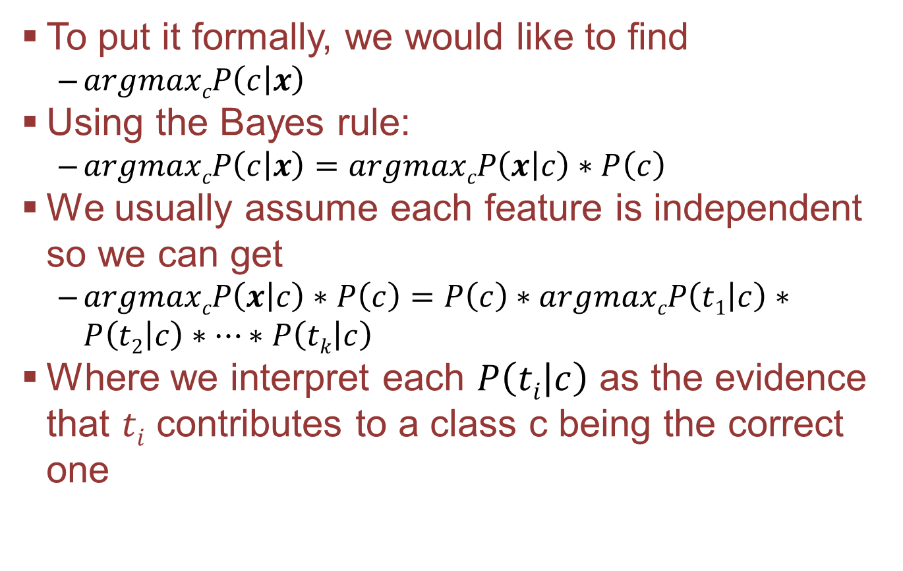
Formalization I
To put it formally, we would like to find
$argmaxcP\left(c | x\right)$
Using the Bayes rule:
$argmaxcP\left(c | x\right)=argmaxcP\left(x | c\right)∗P\left(c\right)$
We usually assume each feature is independent so we can get
$argmaxcP\left(x | c\right)∗P\left(c\right)=P\left(c\right)∗argmaxcP\left(t1 | c\right)∗P\left(t2 | c\right)∗…∗P\left(tk | c\right)$
Where we interpret each $P\left(ti | c\right)$ as the evidence that $ti$ contributes to a class c being the correct one

Slide 66
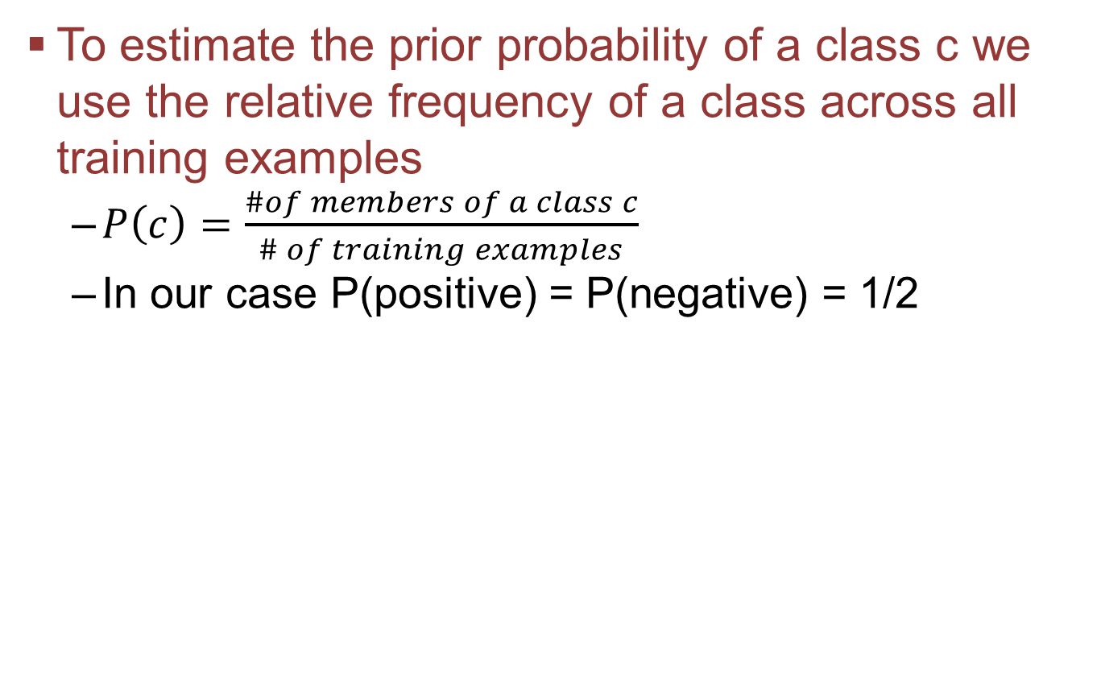
Maximum likelihood estimates
To estimate the prior probability of a class c we use the relative frequency of a class across all training examples
$P\left(c\right)=\frac{\#of members of a class c}{\# of training examples}$
In our case P(positive) = P(negative) = 1/2

Slide 67
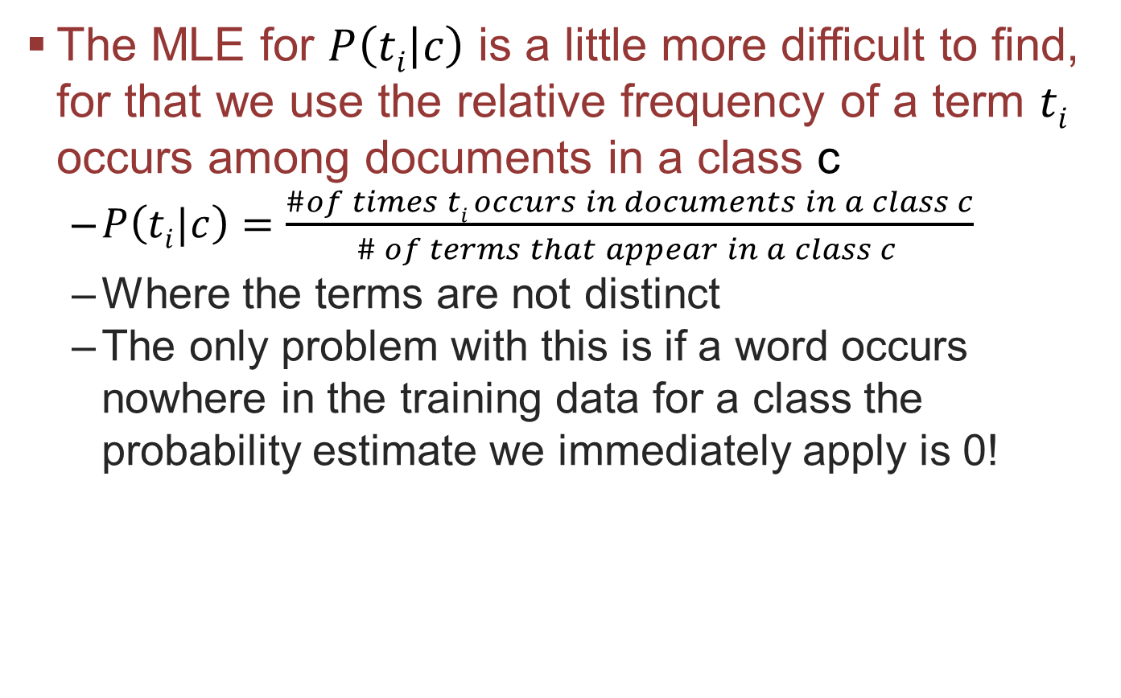
Maximum likelihood estimates
The MLE for $P\left(ti | c\right)$ is a little more difficult to find, for that we use the relative frequency of a term $ti$ occurs among documents in a class c
$P\left(ti|c\right)=\frac{\#of times ti occurs in documents in a class c}{\# of terms that appear in a class c }$
Where the terms are not distinct
The only problem with this is if a word occurs nowhere in the training data for a class the probability estimate we immediately apply is 0!

Slide 68
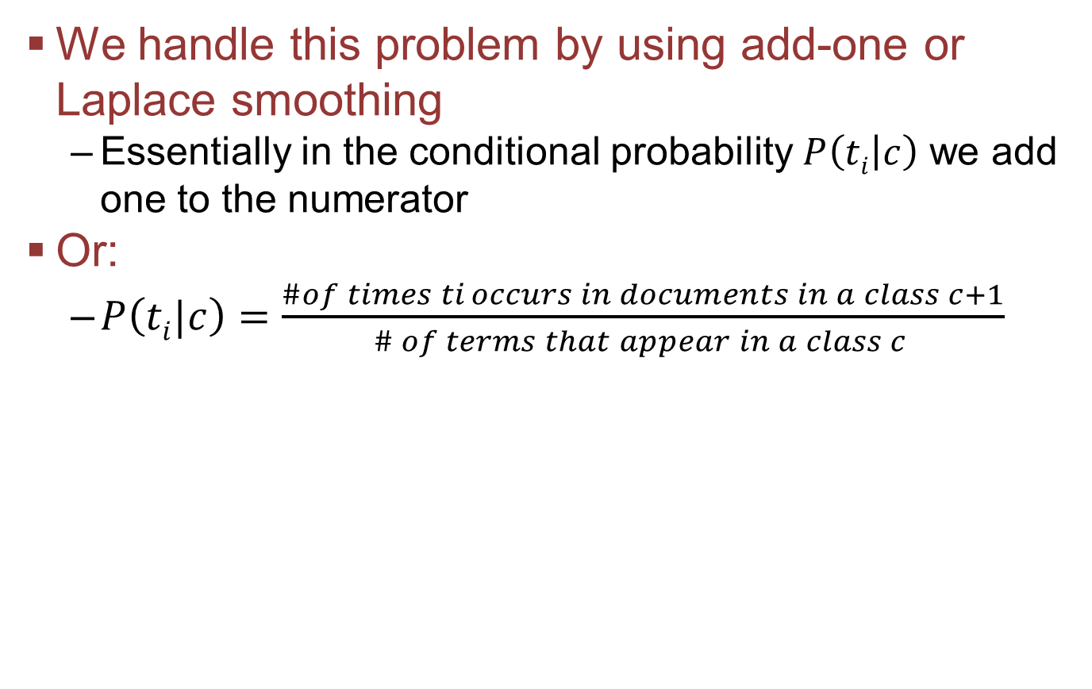
Add-one smoothing
We handle this problem by using add-one or Laplace smoothing
Essentially in the conditional probability $P\left(ti | c\right)$ we add one to the numerator
Or:
$P\left(ti|c\right)=\frac{\#of times ti occurs in documents in a class c+1}{\# of terms that appear in a class c }$

Slide 69
Maximum Entropy Classifier
In Maximum Entropy Classifiers we represent the data in the same way as in Naïve Bayes but we iteratively determine how much each feature (word) t_{i} effects the categorization individually
These are called the weights and we denote them by µ_{i}

Slide 70
Generalized Iterative Scaling
There are several algorithms we can use to find the optimal weight vector but in this case study we will use Generalized Iterative Scaling or (GIS)

Slide 71
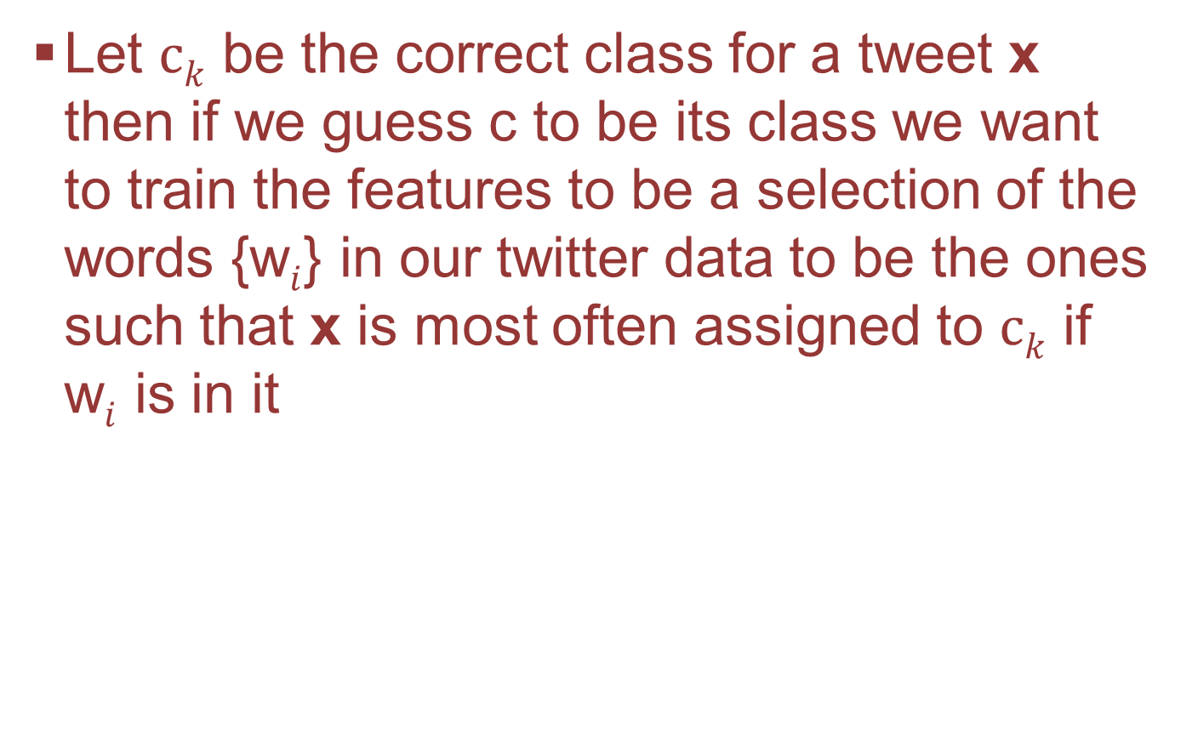
Generalized Iterative Scaling
Let $ck$ be the correct class for a tweet x then if we guess c to be its class we want to train the features to be a selection of the words {w$i$} in our twitter data to be the ones such that x is most often assigned to $ck$ if w$i$ is in it

Slide 72
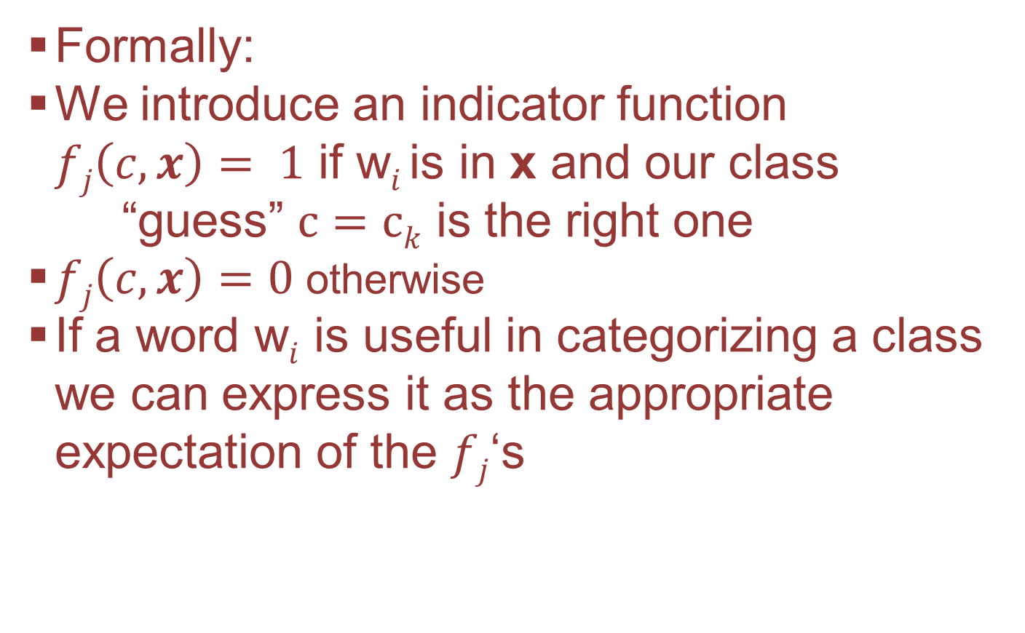
Generalized Iterative Scaling
Formally:
We introduce an indicator function $fj\left(c,x\right)= 1$ if w$i$is in x and our class “guess” $c=ck$ is the right one
$fj\left(c,x\right)=0$ otherwise
If a word w$i$ is useful in categorizing a class we can express it as the appropriate expectation of the $fj$‘s

Slide 73
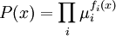
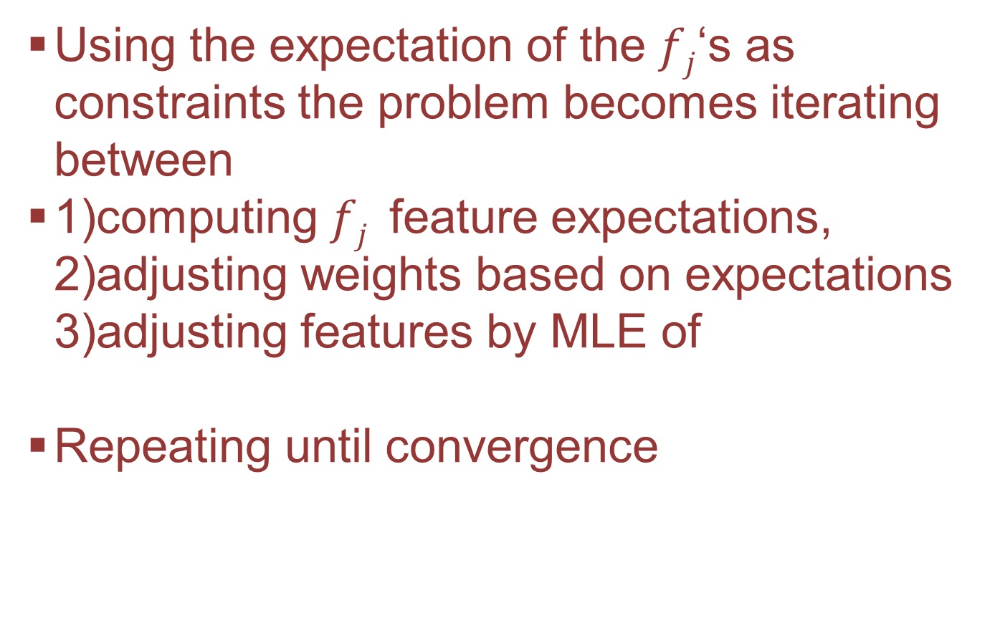
Generalized Iterative Scaling
Using the expectation of the $fj$‘s as constraints the problem becomes iterating between
1)computing $fj$ feature expectations, 2)adjusting weights based on expectations 3)adjusting features by MLE of
Repeating until convergence

Slide 74
The GIS Algorithm
There are several algorithms we can use to find the optimal weight vector but in this case study we will use Generalized Iterative Scaling or (GIS)

Slide 75
Loading the classifiers
The classifiers are already made available to us from the nltk package
We also need to load the metrics from nltk so we know how our classifier is doing

Slide 76
Formatting the data
We want to allow for the possibility of needing to normalize the training data
So in our function to format the training data we need to take our cleaner as an argument
The nltk.classify.classifiers require input as a list of tuples where the first entry in the tuple is a dictionary of features and the second is the assigned category

Slide 77
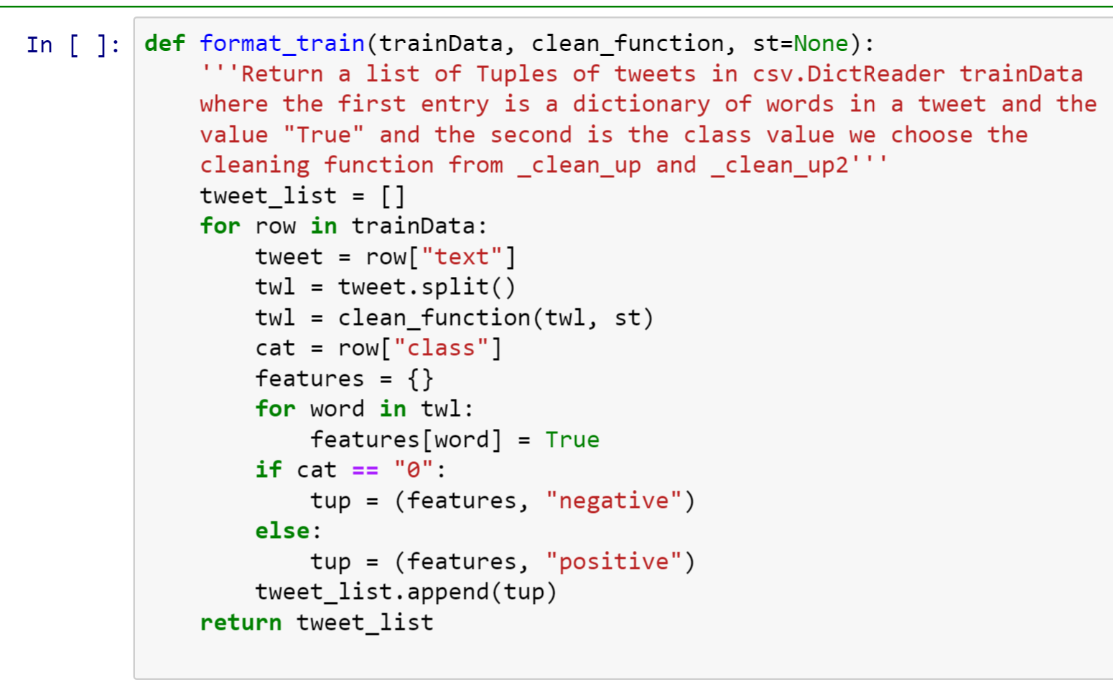
Formatting the data

Slide 78
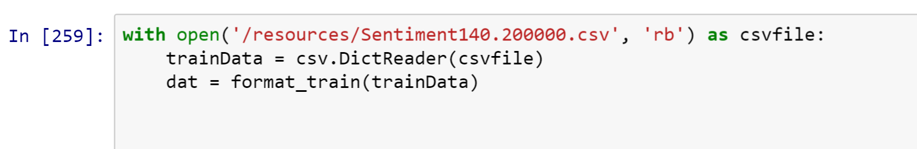
Loading the data
Recall to load the csv data we use

Slide 79
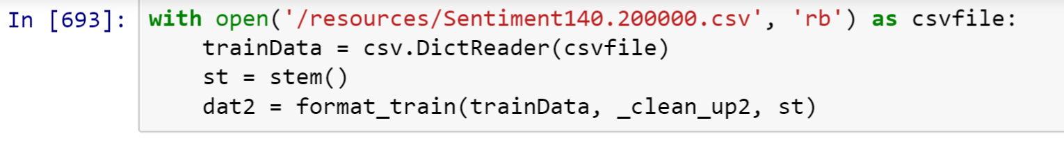
Loading the data – Normalized
Recall to normalize the data we use our _clean_up2 function

Slide 80
Training the classifiers
There are a few algorithm options for the Maximum Entropy Classifier
These algorithms are available also through the nltk classify module

Slide 81
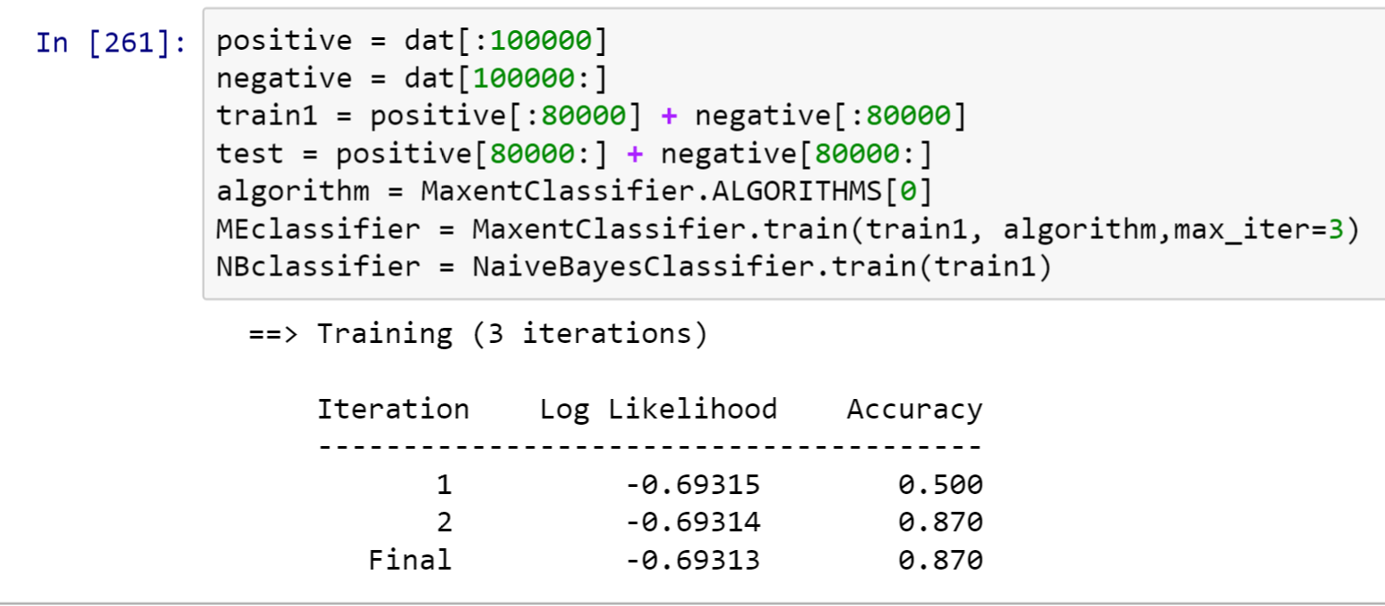
Training the classifiers

Slide 82
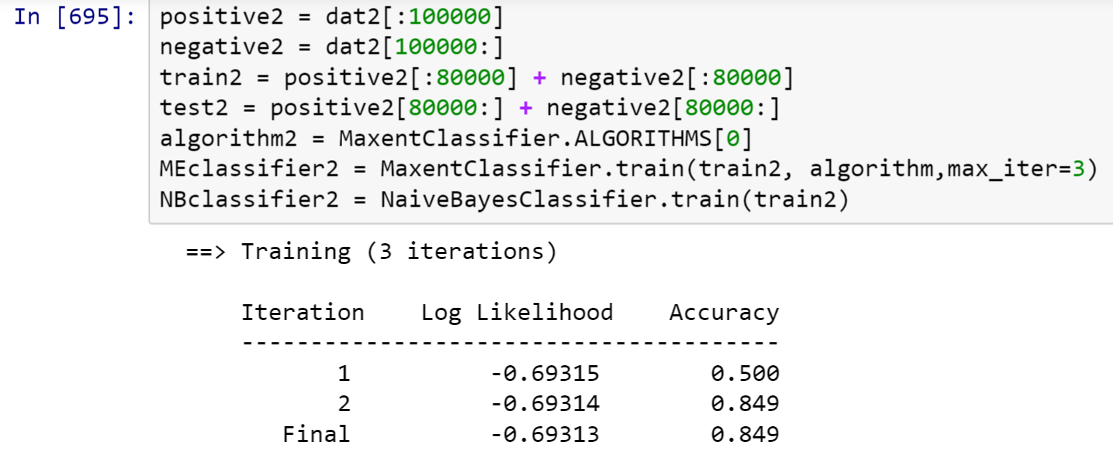
Training the classifiers – Normalized Version

Slide 83
Testing the classifiers: Basic idea
1) For each test case classify the test case with one of our pre-trained classifiers
2) If our classification is the same as the label stored as the second entry in the tuple we got it right, if not we got it wrong
3) Add up the total incorrect classifications and divide by the total number of test cases to get your percentage categorization error

Slide 84
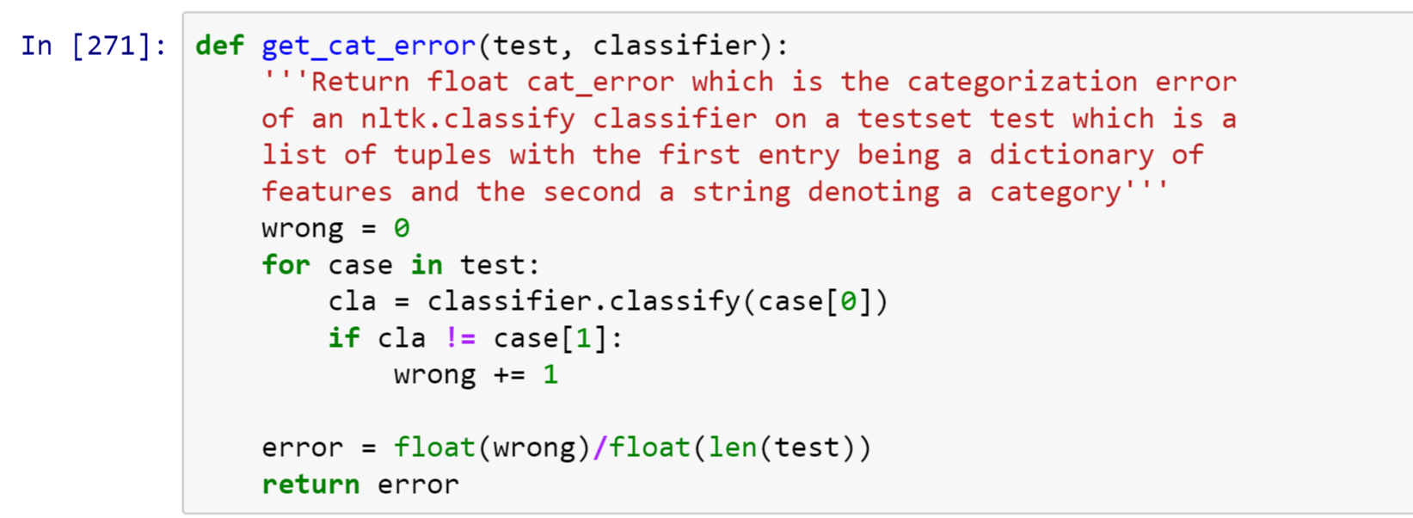
Comparing the Classifiers
First we write a function to get the categorization error

Slide 85
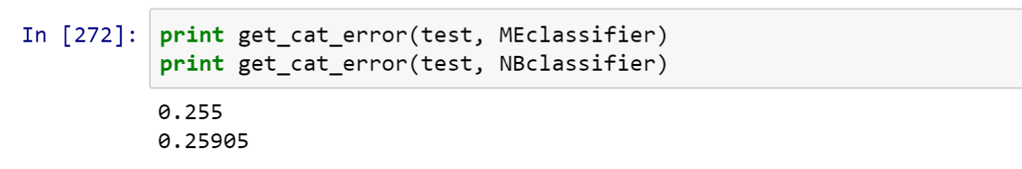
DSWB: Comparing the Classifiers
Now we simply print the result of our function on each classifier
So our Maximum Entropy classifier has marginally better performance with 25.5% of cases miscategorised over 25.9%

Slide 86
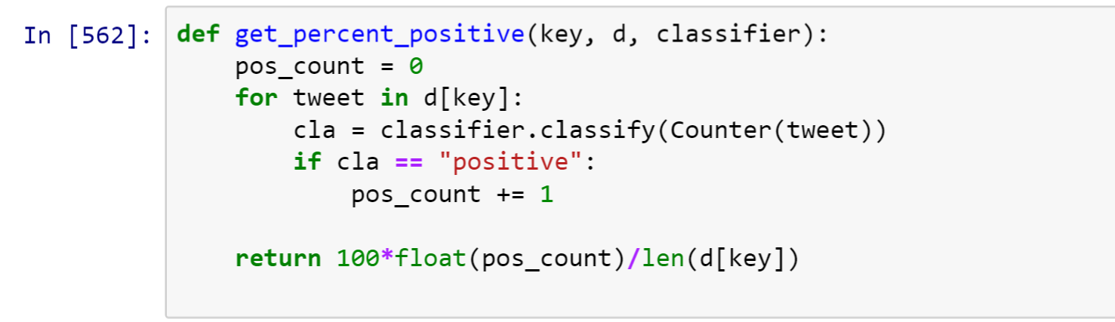
Classifying the test cases
Again, we write a function so avoid repeat code

Slide 87
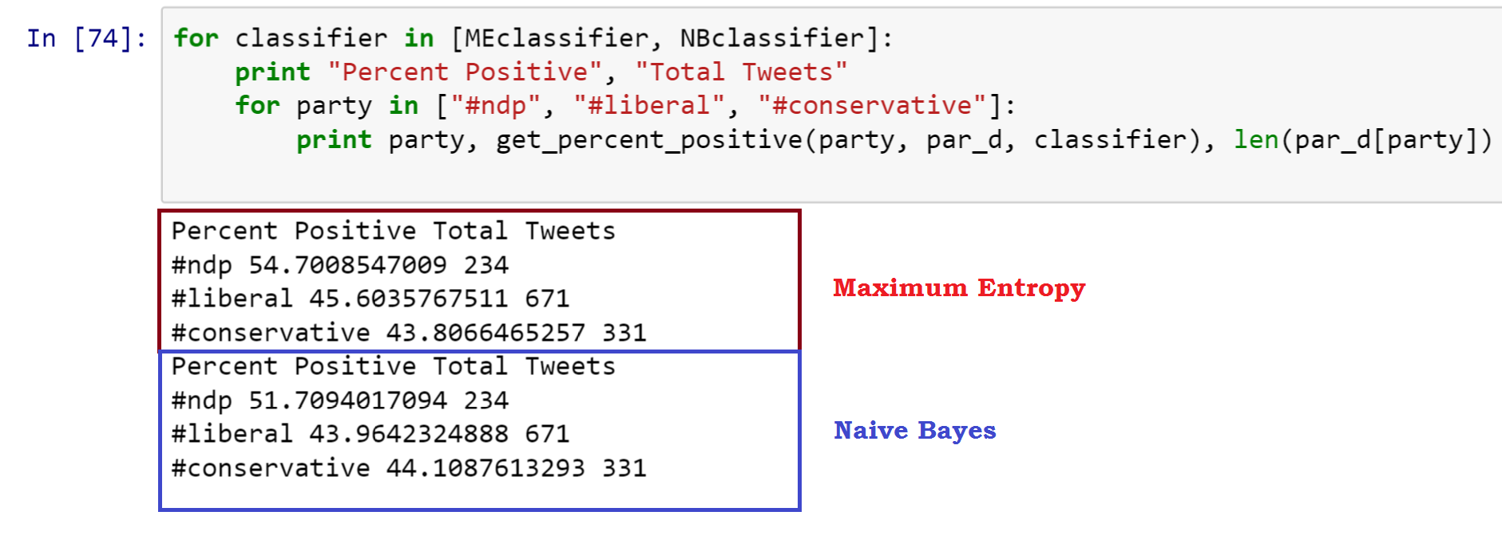
By Party: Comparing the Classifiers
Now we simply print the result of our function on each classifier

Slide 88
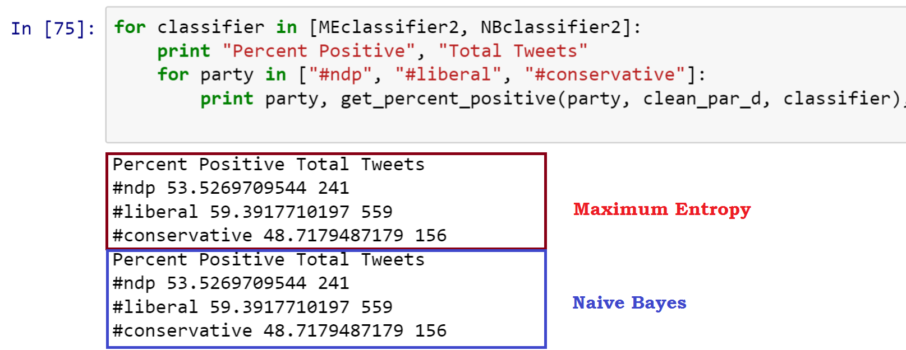
By Party: With Clean data

Slide 89
By Party: Comparing the cleaned and uncleaned data
We can see the cleaned, normalized data gives us much higher positivity percentages across the board
More importantly though, the normalizing greatly restricts the amount of data available by party immensely (except oddly for the ndp)
Because of this (and a manual analysis of the twitter sentiment) it seems that by party the unclean data is better

Slide 90
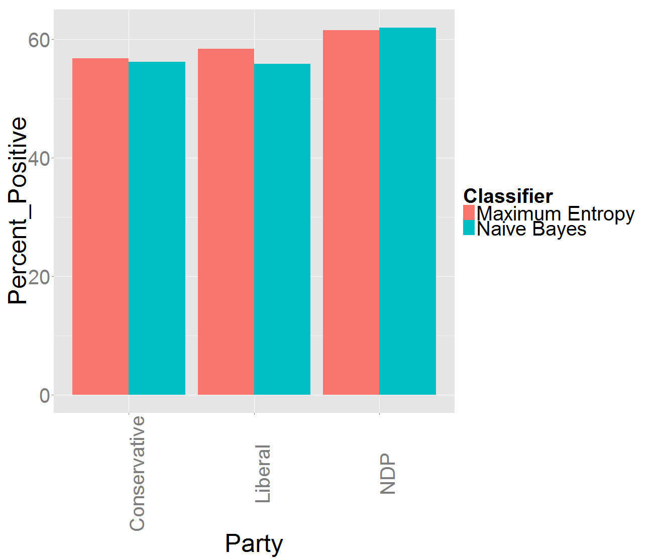
By Party: With unClean data

Slide 91
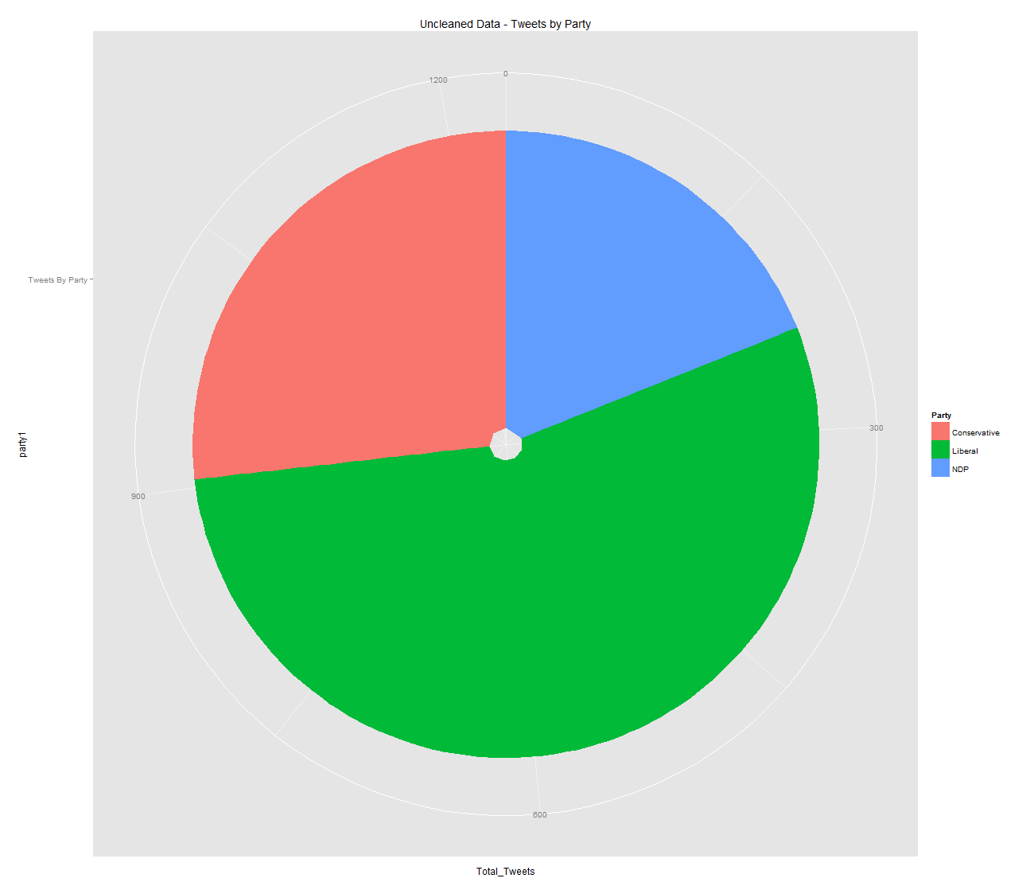
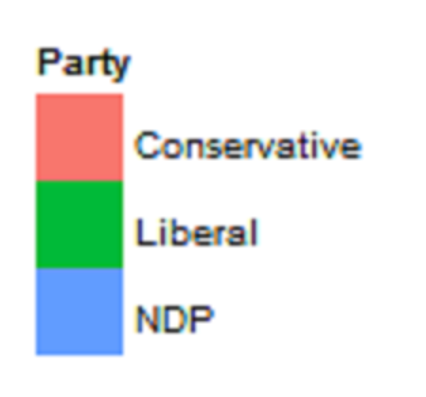
By Party: With unClean data

Slide 92
By Party: Analysis
We can that though the NDP have the highest percentage of tweets being positive, they also are the subject of the fewest tweets
On the other hand the Liberals are far and away the subject of the most tweets and have just over 50% of tweets positive which is comparable to the conservative party
From this analysis we would expect the Liberal Party to win the 42nd Canadian Election

Slide 93
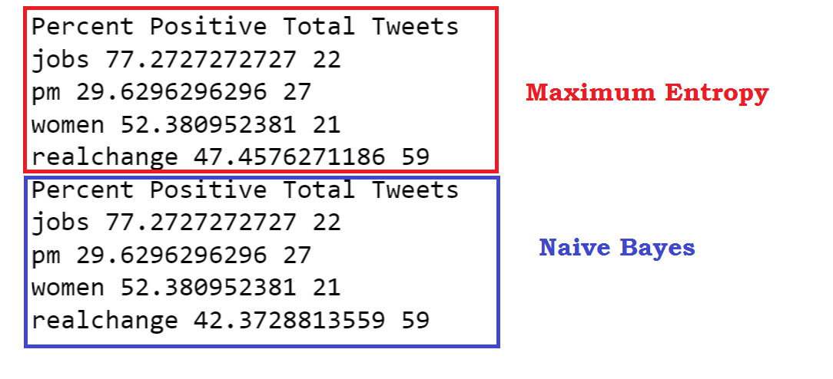
By Subject: With unClean data

Slide 94
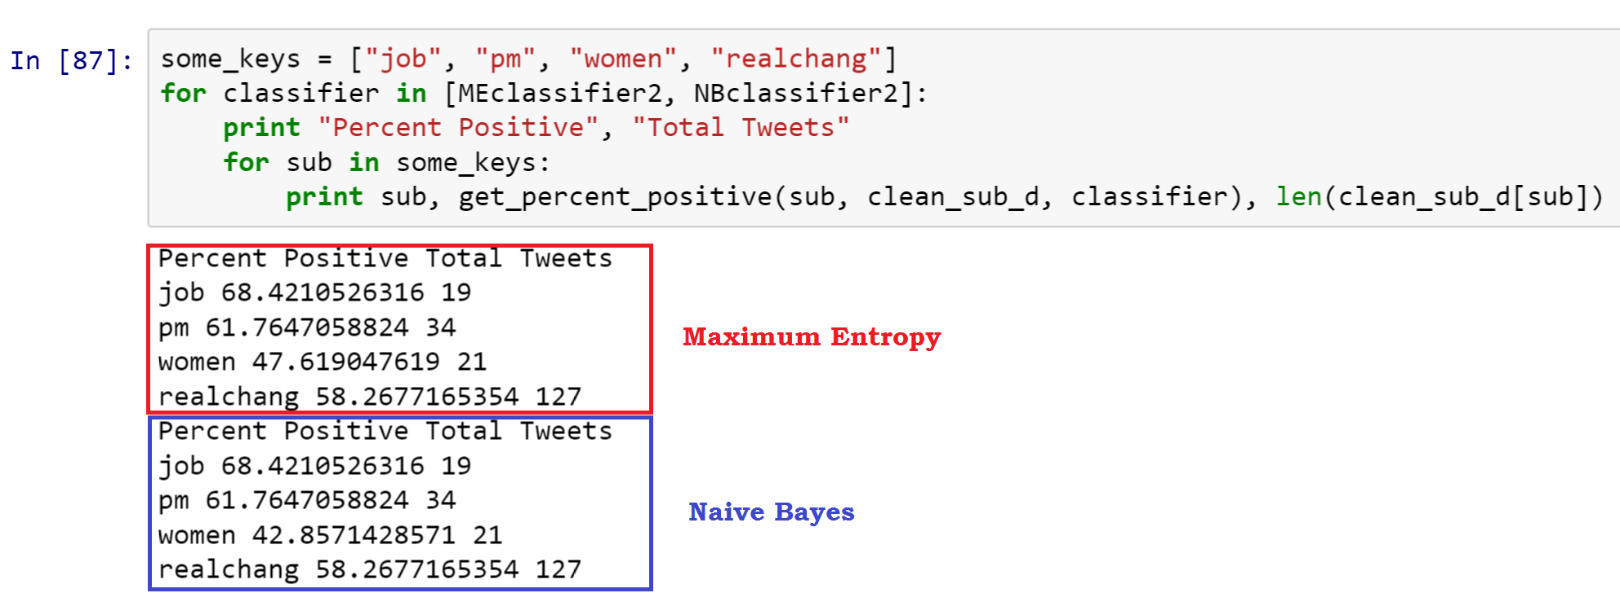
By Subject: With Clean data

Slide 95
By subject: Comparing the cleaned and uncleaned data
We can see the cleaned, normalized data gives us a much slimmer range of positivity
More importantly though, the normalizing greatly increases the amount of data available by subject
This makes sense because it would strict plural nouns, misspellings of nouns and possessive nouns all to the same subject (which is what we want)
Because of this (and a manual analysis of the twitter sentiment) it seems that by subject the clean data is better

Slide 96
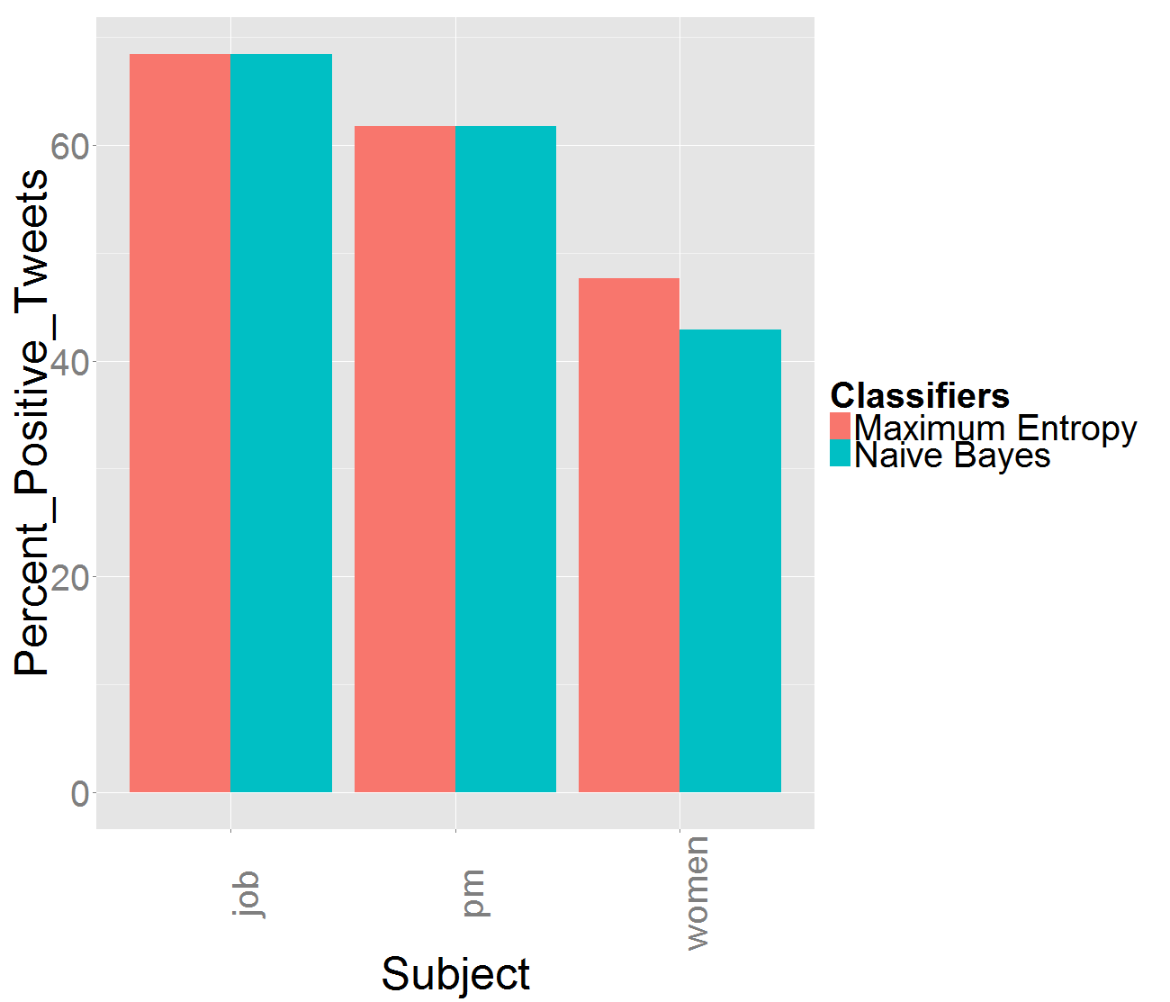
By Subject: With Clean data

Slide 97
By Subject: Analysis
By subject we can see that an overwhelming percentage of tweets about “jobs” are positive
We can also see that tweets with the subject “women” were very negative (~42% with Max Entropy Classifier)
Upon analysis of the tweets most of these tweets were about women’s rights including the niqab and Missing Indigenous Women debates
With that in mind, these results look fairly promising

Slide 98
THANk you !
That concludes our presentation thank you for listening!!

